Slide 1
Project Report Simple Compress Design & Implementation (A simple code C on Linux OS)
Version: 1.0 Author: Thai (Thomas) Date: November 20, 2025

Slide 2
Main Content
Requirement Analysis Define critical requirements for state transitions, igniter, gas control, and temperature sensor thresholds.
System Design Develop architecture, flowchart diagram, and state transition diagram to capture system behavior.
Implementation Implement bare metal firmware on Arduino Uno and Wokwi simulator
Testing & Validation Perform functional tests on temperature ranges, igniter and gas operation, and error handling.
Notes:
The main content of this presentation is all about how I make reliable firmware from analyzing the requirement analysis to performing a verification

Slide 3
Requirement Analysis
List out the critical requirements

Slide 4

The Story Begins…
•Hard‑working elves bake tasty cookies.
•But too many have burned their fancy clothes!
•Santa is being sued for forest fires.
•You must design a SAFE oven controller.
Notes:
Once upon the time
I got a requirements from Santa, elves union. They want me making the first-time ever oven in the tall oak tree. The most important thing, I have to make a safe firmware for that oven accordingly to make sure Santas get out of any fire trouble this winter and deliver the gift for everyone on time

Slide 5
Ultimate Goals
Basics
•Maintain oven at 180°C.
•Simple logic:
•- Too cold → Turn ON
•- Too hot → Turn OFF
Critical Safety Requirement
•If the oven door opens → IMMEDIATELY shut off.
•Close the door → Resume operation.
•Elf union demands ZERO flaming outfits.
System I/O
•Inputs:
•- Temperature sensor (-10°C to 300°C)
•- Door sensor (0V closed, 5V open)
•Outputs:
•- Gas valve control
•- Gas igniter control (auto OFF after 5 sec)
Temperature Measurement Logic
•Sensor provides vref (4.5–5.5V)& signal.
•Signal % of vref:
•- 10% → -10°C
•- 90% → 300°C
•Linear in between.
// Calculate temperature
t = 387.5 * (signal/vref)- 48.75;
Notes:
Based on requirement, I made a 4 groups of goal

Slide 6
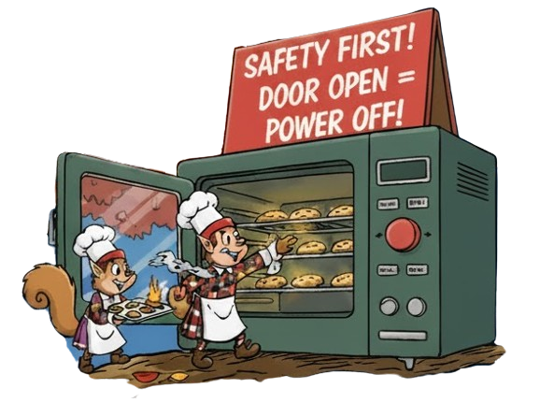
Mission
Maintain 180°C
Door‑open auto shutoff
Control gas valve and igniter safely
Protect elves → protect forests → protect Santa from lawsuits! He’s going to deliver our Xmas gift on time.
Notes:
The mision is quite clear. Try to main a setpoint temperature.

Slide 7
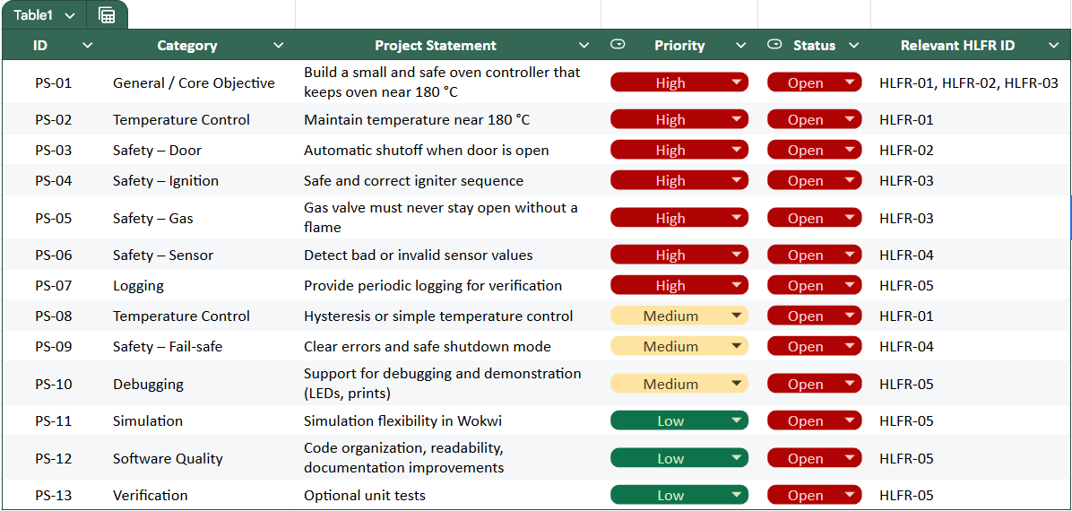
Critical requirements
LlNK FULL SYSTEM ANALYSIS
Notes:
3_High-level functional requirements
Requirement Traceabiilty Matrix

Slide 8
System Design
System Architecture Design
Flowchart Diagram
State Transition Diagram

Slide 9
System architecture diagram
ptx_elf_cookie_oven.ino
Control layer
ptx_oven_control
ptx_oven_config
ptx_sensor_filter
ptx_actuator
ptx_logging
HAL
api.cpp
Hardware layer
Temperature Sensor
(Analog Input)
Door Switch
(Digital Input)
Gas Valve
(Digital Output)
Igniter
(Digital Output)
System LED
(Digital Output)

Slide 10

Flowchart diagram
Start
Door open OR
Sensor fault?
Yes
Shutdown
(Gas=OFF, Ign = OFF, State=IDLE)
Read & filter sensors
(vref, temperature signal)
No
Evalue faults with
Timing window
Sensor Stabilization
Get door state
Apply Outputs
Compute Temperature
Periodic Logging
End

Slide 11
State transition diagram
Idle
System Fault
Temperature < 175°C
& No error detected
No flame detected/
Door open/
Sensor Fault
Igniting
Error Handle
(tbd)
5s elapsed
Door open/
Sensor Fault
Temperature > 185°C
Heating
typedef enum {
PTX_HEATING_STATE_IDLE = 0, // Outputs off; waiting for heat demand.
PTX_HEATING_STATE_IGNITING, // First 5 seconds after gas turns on (igniter ON).
PTX_HEATING_STATE_HEATING, // Post-ignition; flame expected; igniter OFF.
PTX_HEATING_STATE_LOCKOUT // Safety lockout after max failed attempts.
} ptx_heating_state_t;

Slide 12
Implementation
Pseudocode
Doxygen Detailed Design (tbd)
GitHub source code

Slide 13
Directory structure of project
ptx_elf_cookie_oven
├───.github
│ └───workflows
└───tests
├───mocks
└───stubs
Github CI
Testing
Requirement
requirements.md
notes.md
diagram.json
CMakeLists.txt
Wokwi HW simulator
Source code
ptx_elf_cookie_oven.ino
api.cpp
api.
ptx_actuator.cpp
ptx_actuator.h
ptx_oven_control.cpp
ptx_oven_control.h
ptx_sensor_filter.cpp
ptx_sensor_filter.h
ptx_logging.cpp
ptx_logging.h
ptx_oven_config.cpp
ptx_oven_config.h
Notes:
Reasoning for Task Design:
Voltage Sensor and Pump Current Sensor tasks are lower priority because they are periodic tasks responsible for reading data and setting error flags. They don’t need real-time intervention.
Pump Control Task needs higher priority because it directly controls the pump, which is critical to the system. Immediate response is necessary to ensure the pump operates only when the state is valid.
State Machine Task is the highest priority to manage state transitions promptly. It has to monitor both the voltage and current sensors and respond accordingly, handling errors and transitions between Charging, Discharging, and Standby states.

Slide 14
Pseudocode – Configuration
typedef struct {
uint32_t ignition_duration_ms; // Duration igniter stays ON after gas opens (df: 5000ms)
uint32_t periodic_log_ms; // Interval between periodic status logs (df: 1000ms)
uint32_t sensor_fault_window_ms; // Out-of-range duration before latching fault (1000ms)
uint32_t auto_resume_delay_ms; // Valid readings duration before clearing fault (3000ms)
float vref_min_v; // Minimum acceptable reference voltage (default: 4.5V)
float vref_max_v; // Maximum acceptable reference voltage (default: 5.5V)
float temp_target_c; // Target temperature for control (default: 180.0°C)
float temp_delta_c; // Hysteresis half-band around target (default: 2.0°C)
/* Ignition safety parameters */
uint8_t max_ignition_attempts; // Maximum number of ignition retry attempts (default: 3)
/* Others */
uint16_t iteration_period; // 100ms
} ptx_oven_config_t;
LlNK FULL SOURCE CODE

Slide 15
Pseudocode – Oven status
/**
* @brief Public status snapshot of the oven control loop.
*/
typedef struct {
float vref_volts; // Reference voltage from sensor (V). */
float signal_volts; // Sensor signal (V), referenced to vref. */
float temperature_c; // Computed temperature (°C). */
bool door_open; // Door state: true=open, false=closed. */
bool gas_on; // Gas valve command output. */
bool igniter_on; // Igniter command output. */
ptx_heating_state_t state; // Current heating state. */
bool vref_fault; // True if vref not in [4.5, 5.5] V. */
bool signal_fault; // True if signal not in [10%, 90%] of vref. */
bool sensor_fault; // Aggregate: vref_fault || signal_fault. */
uint8_t ignition_attempt; // Current ignition attempt counter (1-based). */
bool ignition_lockout; // True if in safety lockout after failed ignitions. */
} ptx_oven_status_t;
LlNK FULL SOURCE CODE

Slide 16
Pseudocode – State machine
static void ptx_update_heating(uint32_t now_ms) {
/* Door and sensor faults override everything - force shutdown regardless of state */
/* Hysteresis thresholds */
/* State machine logic */
switch (pti_status.state) {
case PTX_HEATING_STATE_IDLE:
/* Check if heating is needed */
if (pti_status.temperature_c <= temp_on) {
/* Start ignition sequence */
pti_status.state = PTX_HEATING_STATE_IGNITING; } break;
case PTX_HEATING_STATE_IGNITING:
/* Wait for ignition period to complete */
if ((now_ms - pti_ignition_start_ms) >= cfg->ignition_duration_ms) {
/* Ignition period ended, check for flame */
/* Flame detected - successful ignition */
pti_status.state = PTX_HEATING_STATE_HEATING;} break;
case PTX_HEATING_STATE_HEATING:
/* Check if reached upper temperature threshold */
if (pti_status.temperature_c >= temp_off) {
pti_status.state = PTX_HEATING_STATE_IDLE;} break;
Default: /* Invalid state - reset to IDLE */
break;}
}
LlNK FULL SOURCE CODE

Slide 17
Test Report
Temperature Sensor and Door switch, igniter, gas (main features)

Slide 18
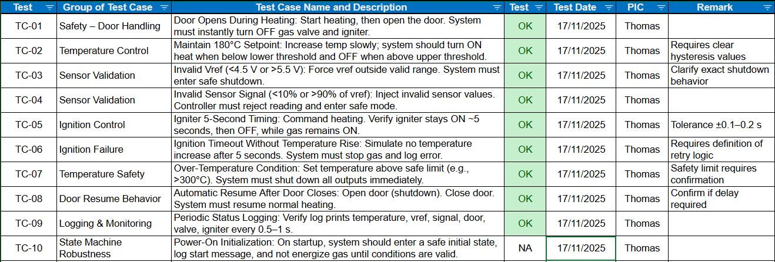


Test report - Critical cases only
LlNK FULL TEST REPORT

Slide 19
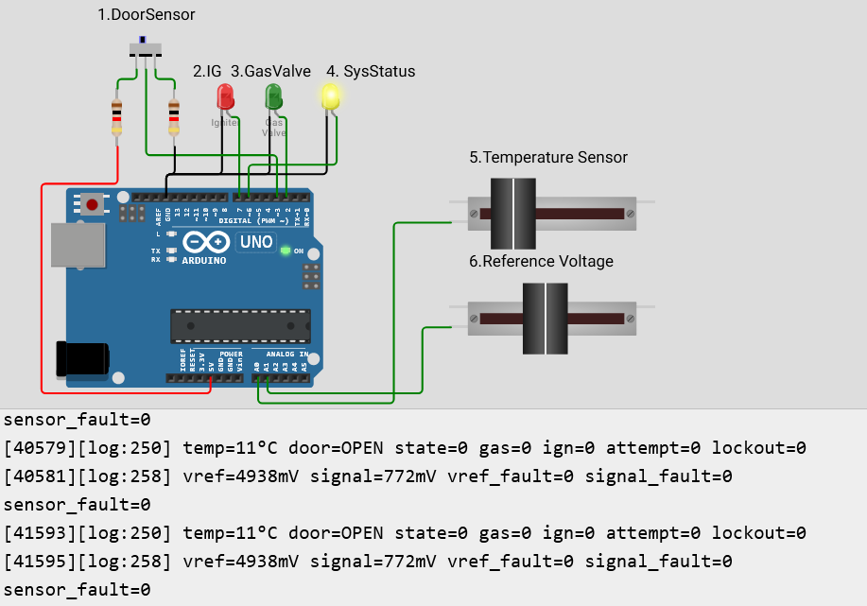
Test strategy: Initial state—Door open
3.Change state from STANDBY to CHARGING
when voltage > 2.1V

Slide 20
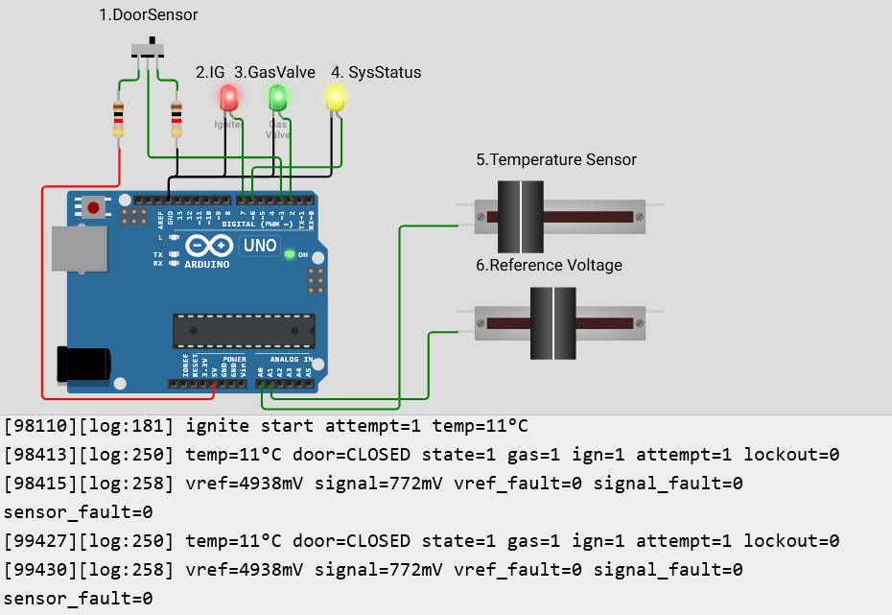
Test strategy: Door closed - Temp 11°C

Slide 21
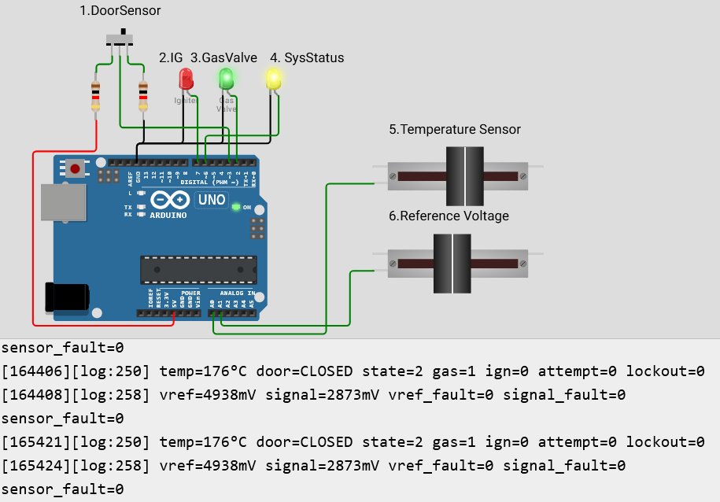
Test strategy: Door closed - Temp 176°C
3.Change state from STANDBY to CHARGING
when voltage > 2.1V

Slide 22
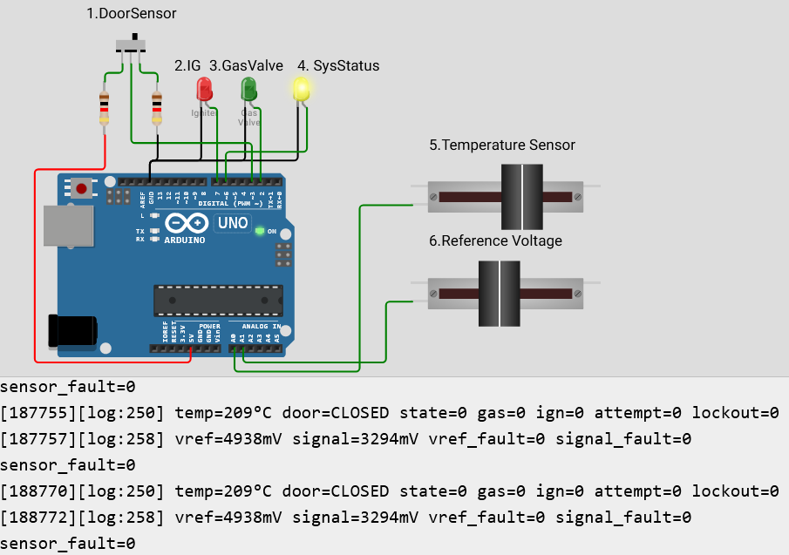
Test strategy: Door closed - Temp 209°C

Slide 23
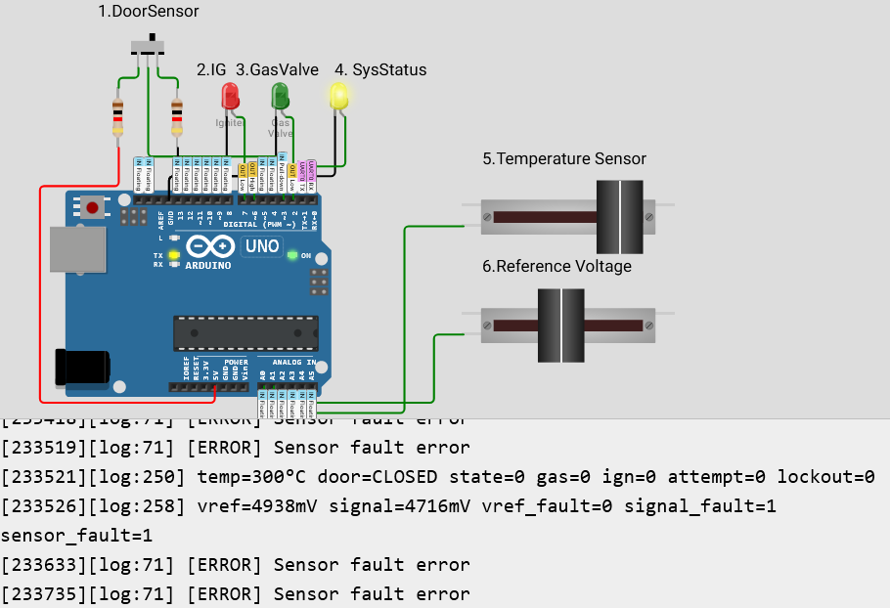
Test strategy: Door closed—temperature over 300°C

Slide 24
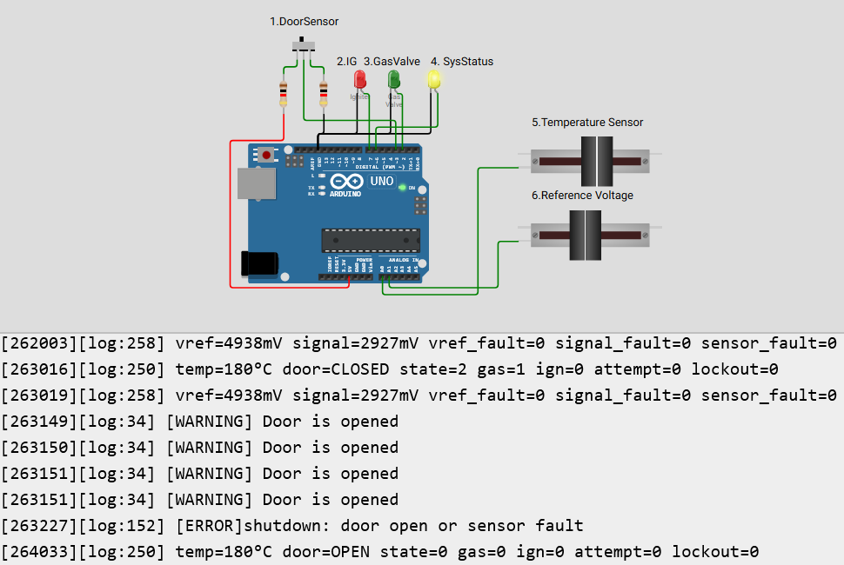
Test strategy: Door open - Temp 180°C

Slide 25
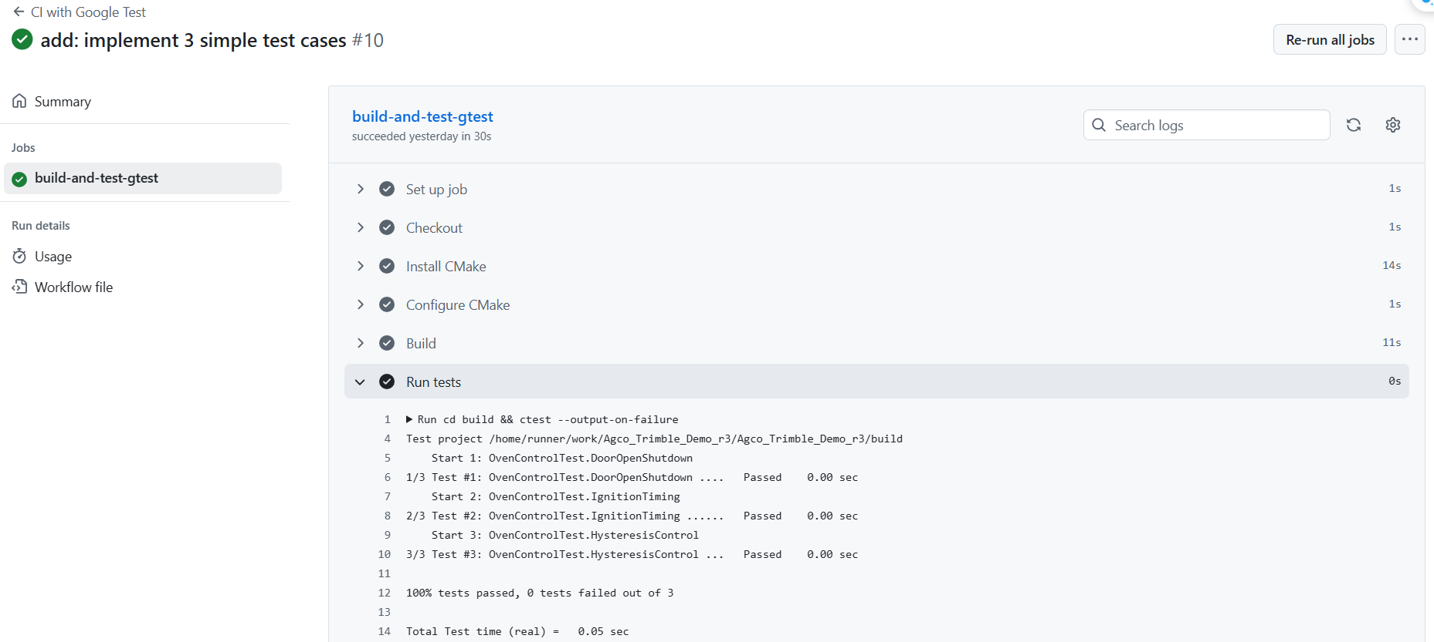


CI with Google test on Github
Almost, Manitoba cold turned them into cookie ice cubes again!
Are the cookies ready yet, eh?

Slide 26


Release note
Project: PTX Oven demo Release Version: commit 1d02736 Hardware Target: Arduino Uno (https://wokwi.com/projects/447565694838811649)
📦 Firmware
Source Code: [GitHub Repository]: https://github.com/thaidao/Agco_Trimble_Demo_r3
Firmware compiled and tested for Arduino Uno (Wokwi) board.
✅ Test Report
Document: PTX_Oven_TestReport.xlsx (version 1.0)
https://docs.google.com/spreadsheets/d/1LY6pKCF0DQKYStngSQ7gvPw5gUtswfMH/edit?gid=69061649#gid=69061649
Status: All critical functions validated on target hardware.
No blocking issues identified.
📑 Project Documentation Document: ProjectReport.pptx (version 1.0)
https://docs.google.com/presentation/d/103Ok3i8cX7fiv5sxmxNIwVu5xOM23Qk9/edit?usp=sharing&ouid=117617683072114257206&rtpof=true&sd=true
Contains system overview, implementation details, and test summary.

Slide 27

Thank you !

Slide 28
Appendix
Design a GUI by TouchGFX

Slide 29
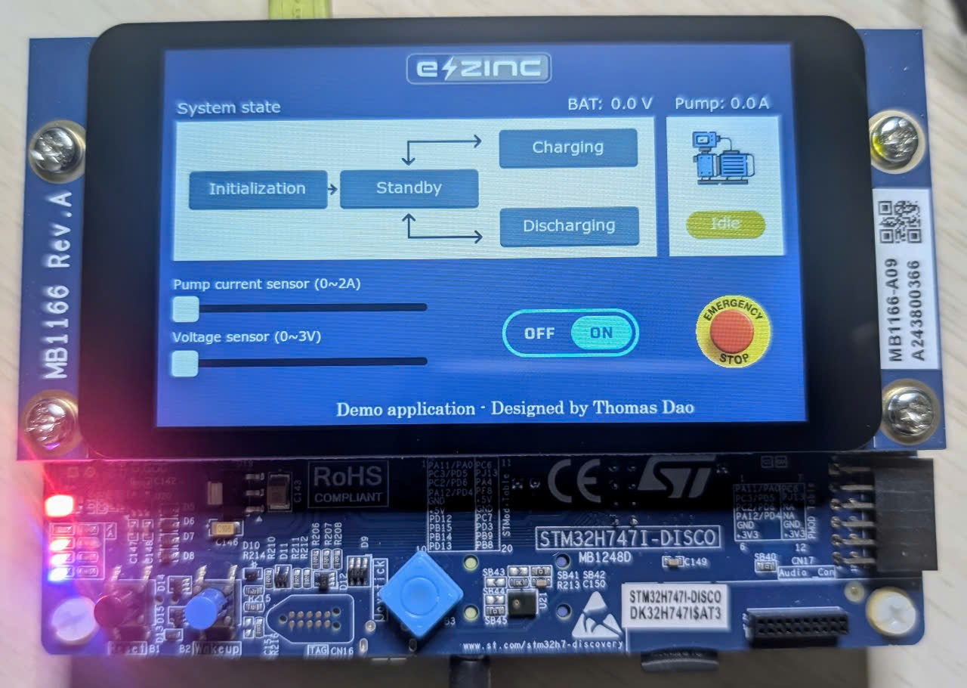
Real product
BAT system

Slide 30
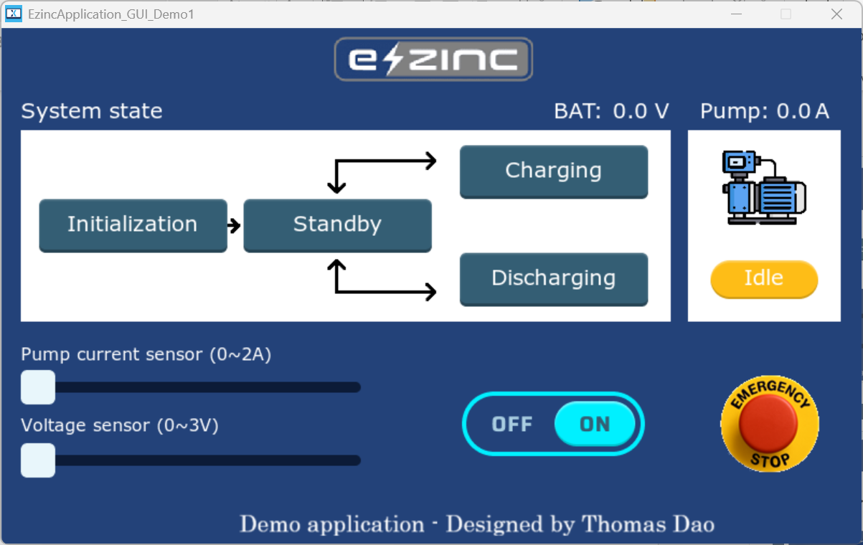
Application GUI
1. Battery Voltage
Pump Current Sensor
5. Realtime
State system
BAT system
2. Pump status
(Idle/Running)
6. Create dummy sensor value for a demonstration purpose
3. Emergency Stop
Button
4. Start/Stop system

Slide 31
Voltage Sensor Test Cases
No | Group of Test Case | Test Case Name and Description | Test Result | Test Date | PIC | Remark
TC08 | Voltage Sensor | Valid Charging Range: Apply 2.2 V (within range). Ensure sensor remains in Charging state. | OK | 07/09/2025 | Thomas
TC10 | Voltage Sensor | Invalid Charging Range: Apply 2.0 V (below range). Error flag should set, state transitions to Standby. | OK | 07/09/2025 | Thomas
TC11 | Voltage Sensor | Invalid Charging Range: Apply 2.6 V (above range). Error flag should set, state transitions to Standby. | OK | 07/09/2025 | Thomas
TC12 | Voltage Sensor | Valid Discharging Range: Apply 1.1 V (within range). Ensure sensor remains in Discharging state. | OK | 07/09/2025 | Thomas
TC14 | Voltage Sensor | Invalid Discharging Range: Apply 0.8 V (below range). Error flag should set, state transitions to Standby. | OK | 07/09/2025 | Thomas
TC15 | Voltage Sensor | Invalid Discharging Range: Apply 1.4 V (above range). Error flag should set, state transitions to Standby. | OK | 07/09/2025 | Thomas

